Slide 1
Segmentation network Mask R-CNN
He Yiming

Slide 2
Introduce
Segmentation network Mask R-CNN is a classic example of image segmentation technology.I will explain it in the following 5 points.
1.Feature Pyramid Networks(FPN)
2.Mask R-CNN network structure
3.Process flow of Mask R-CNN
4.RoiAlign
5.RPN

Slide 3
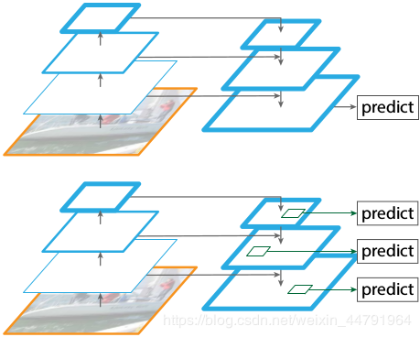
FPN
FPN refers to Feature Pyramid Networks. FPN is proposed to achieve better integration of feature maps. Generally, feature maps of the last layer are directly used by networks. However, the location and resolution are relatively low, and it is easy to detect relatively small objects. The function of FPN is to integrate feature maps from the bottom layer to the top layer, so as to make full use of the extracted features at each stage.
Feature maps are represented by blue Outlines, with thicker Outlines representing semantically stronger feature maps.

Slide 4
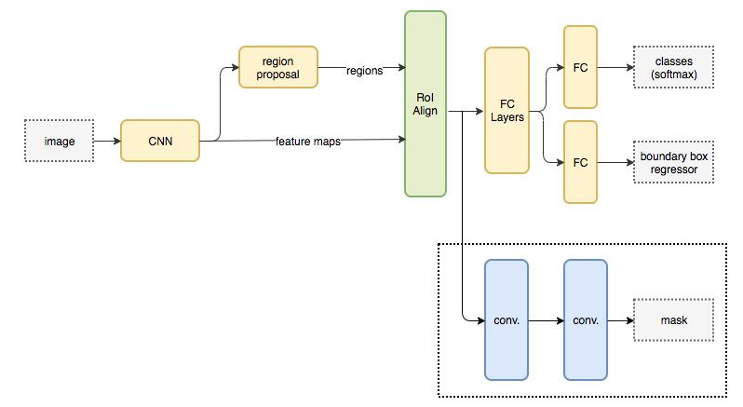
Mask R-CNN network structure
The general framework of Mask R-CNN is similar to that of Faster-RCNN framework. After the basic feature network, a fully connected segmentation subnet is added, and the original two tasks (classification + regression) become three tasks (classification + regression + segmentation). Mask R-CNN is a two-stage framework, the first phase scans the image and generates candidate regions, the second phase classifies the candidate regions and generates bounding boxes and masks.

Slide 5
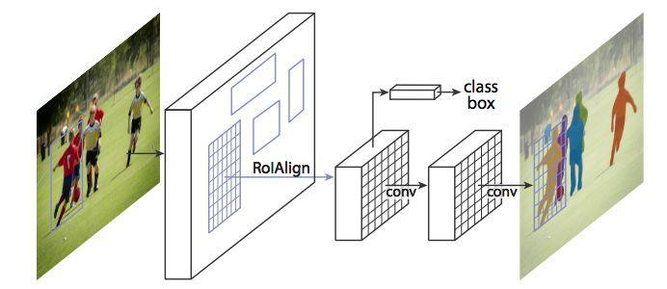
Mask R-CNN network structure

Slide 6
Process flow of Mask R-CNN
1.The input image is preprocessed
2.The pre-processed image information is input into the pre-trained neural network to obtain the feature map
3.Set a predetermined ROI for each point in this feature map to obtain multiple candidate ROIs
4.These candidate ROIs were sent to RPN network for binary classification and BB regression to filter out part of candidate ROI.
5.ROIAlign the remaining ROI (ROIAlign is Mask R-CNN innovation point 1, which is a great improvement over ROIPooling);
6.Finally, these ROIs are classified, BB regression, and MASK generation (the introduction of FCN to generate Mask is innovation point 2, making this network capable of segmentation tasks).
Notes:
工艺流程
1.对输入图像进行预处理
2.将预处理后的图像信息输入到预训练的神经网络中，得到特征映射
3.为特征图中的每个点设定一个预定的ROI，从而获得多个候选ROI
4.将候选ROI送入RPN网络进行二值分类和BB回归，过滤掉部分候选ROI。
5.ROIAlign剩余ROI (ROIAlign是Mask R-CNN创新点1，比ROIPooling有很大改进);
6.最后，对这些roi进行分类、BB回归和MASK生成(引入FCN生成MASK是创新点2，使该网络能够完成分割任务)。

Slide 7
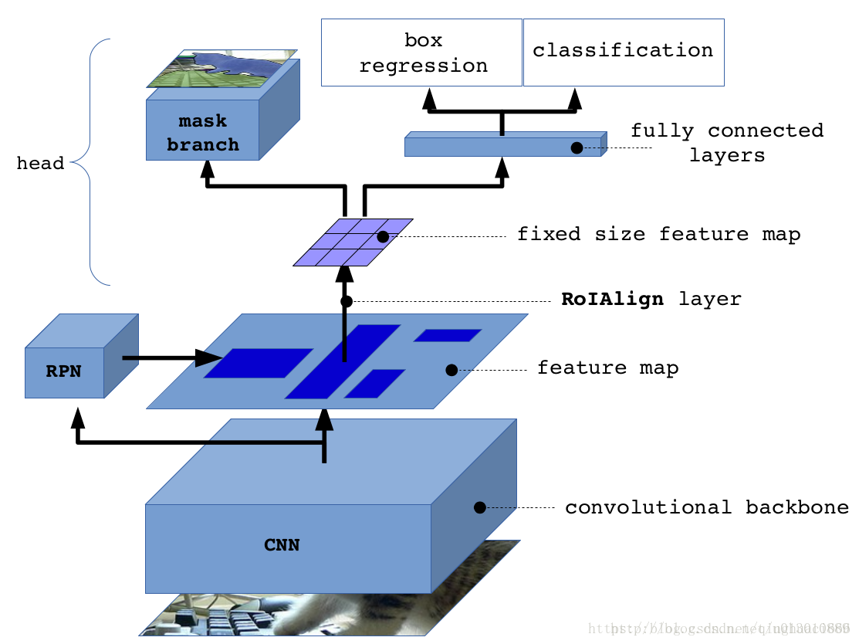
Process flow of Mask R-CNN

Slide 8
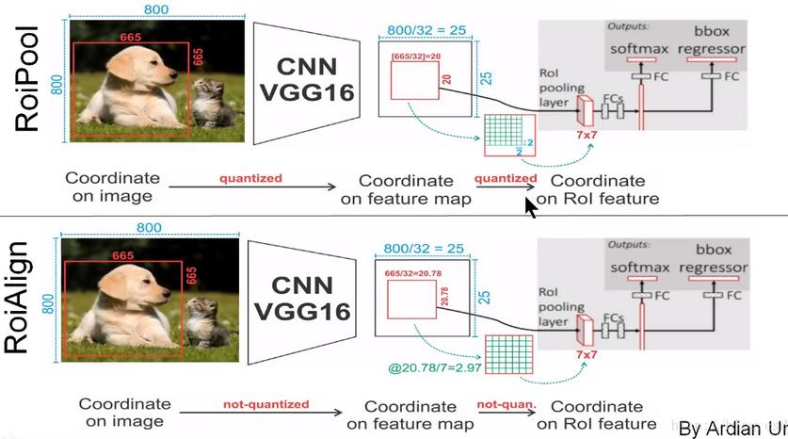
RoiAlign
In the RoI pooling process, two rounds are performed. Although it only looks like a decimal number on feature maps, there will be a big deviation when the feature map is restored to the original map. For example, 0.78 (665/32=20.78) is rounded off in the first round. When the original image is restored, it is 20*32=640. There is a deviation of 25 pixels in the first round, and the deviation after the second round is even larger. This may not be a large error for classification and object detection, but it is a very large error for instance segmentation, because it is visually obvious that the mask is out of alignment. RoIAlign was introduced to solve this problem.

Slide 9
RPN
The essence of an RPN is a "sliding window-based classless obejct detector." Because it is used to generate regional recommendations, rather than directly classify or detect images. RPN generates a series of candidate regions on the image through sliding window, and then sends these candidate regions into the subsequent classifier or detector for classification or detection as ROI (region of interest). Therefore, RPN is more accurately described as an algorithm for generating candidate regions, rather than a direct target detection algorithm.
Notes:
工艺流程
1.对输入图像进行预处理
2.将预处理后的图像信息输入到预训练的神经网络中，得到特征映射
3.为特征图中的每个点设定一个预定的ROI，从而获得多个候选ROI
4.将候选ROI送入RPN网络进行二值分类和BB回归，过滤掉部分候选ROI。
5.ROIAlign剩余ROI (ROIAlign是Mask R-CNN创新点1，比ROIPooling有很大改进);
6.最后，对这些roi进行分类、BB回归和MASK生成(引入FCN生成MASK是创新点2，使该网络能够完成分割任务)。

Slide 10
RPN
The structure of RPN is shown in the figure below. The feature graph output by backbone enters different branches after a 3 * 3 convolution, corresponding to different 1 * 1 convolution. The first convolution is the positioning layer, which outputs four coordinate offsets of anchor. The second branch (also called the classification layer) corresponds to the binary classification task, which generates the foreground and background probabilities for each anchor point. The foreground indicates that the anchor point contains the target, while the background indicates that the anchor point does not contain the target. In the classification layer, the foreground and background probabilities of the anchor points are normalized by a sigmoid function to ensure that they are between 0 and 1.
Notes:
工艺流程
1.对输入图像进行预处理
2.将预处理后的图像信息输入到预训练的神经网络中，得到特征映射
3.为特征图中的每个点设定一个预定的ROI，从而获得多个候选ROI
4.将候选ROI送入RPN网络进行二值分类和BB回归，过滤掉部分候选ROI。
5.ROIAlign剩余ROI (ROIAlign是Mask R-CNN创新点1，比ROIPooling有很大改进);
6.最后，对这些roi进行分类、BB回归和MASK生成(引入FCN生成MASK是创新点2，使该网络能够完成分割任务)。

Slide 11
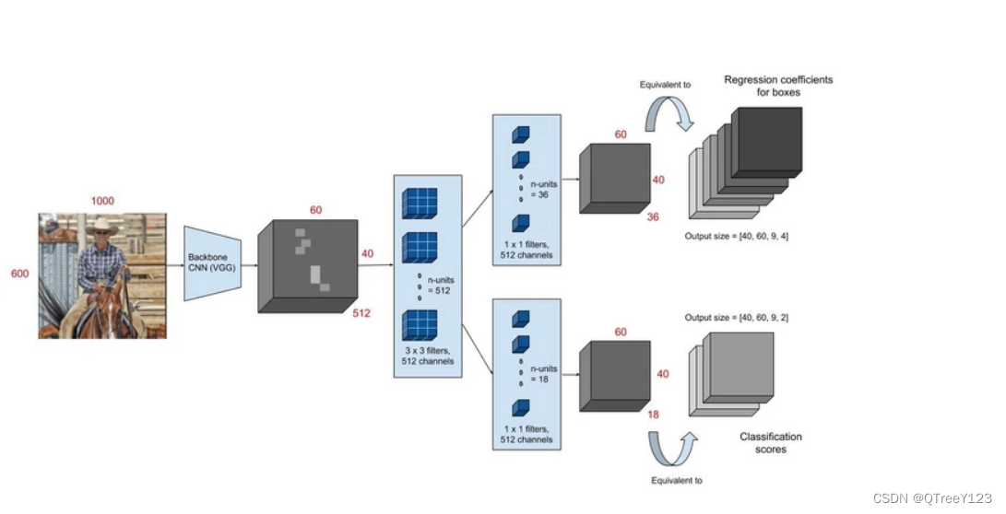
RPN
Notes:
工艺流程
1.对输入图像进行预处理
2.将预处理后的图像信息输入到预训练的神经网络中，得到特征映射
3.为特征图中的每个点设定一个预定的ROI，从而获得多个候选ROI
4.将候选ROI送入RPN网络进行二值分类和BB回归，过滤掉部分候选ROI。
5.ROIAlign剩余ROI (ROIAlign是Mask R-CNN创新点1，比ROIPooling有很大改进);
6.最后，对这些roi进行分类、BB回归和MASK生成(引入FCN生成MASK是创新点2，使该网络能够完成分割任务)。

Slide 12
RPN
Detailed process of RPN
Step 1: Define base anchor (base_anchor) generation. The number of base anchor frame base_anchor = the number of aspect ratio * the number of scaling ratio of anchor, that is, anchors_num = len(ratios) * len(scales).
Step 2: According to base_anchor, for each pixel on the feature map, 9 different size bounding boxes are generated around it.
Step 3: Screening of anchor. Firstly, the coordinate offset output of the positioning layer is applied to all the generated anchors, and the output of the positioning layer is the coordinate offset. Specifically, RPN will output four coordinate offsets for each generated anchor box, which respectively represent the distance of offset of the top left corner and bottom right corner coordinates of the current anchor box along the x axis and y axis, respectively. These offsets are obtained by training with the calculation loss of the label box. These four offsets are output by the positioning layer, through which the anchor box can be precisely adjusted to the position of the target.
Notes:
工艺流程
1.对输入图像进行预处理
2.将预处理后的图像信息输入到预训练的神经网络中，得到特征映射
3.为特征图中的每个点设定一个预定的ROI，从而获得多个候选ROI
4.将候选ROI送入RPN网络进行二值分类和BB回归，过滤掉部分候选ROI。
5.ROIAlign剩余ROI (ROIAlign是Mask R-CNN创新点1，比ROIPooling有很大改进);
6.最后，对这些roi进行分类、BB回归和MASK生成(引入FCN生成MASK是创新点2，使该网络能够完成分割任务)。

Slide 13
Thanks

